Slide 1
Information Visualization Project Proposal and Dataset
G01-A
70493 – Tiago Nascimento
76102 – Miguel Cruz
76394 – Daniel Trindade

Slide 2
INITIAL DATASET
01

Slide 3
Initial Dataset
Description
All Winners – contains the podium finishers of all time, for each edition and for each sport
Data sample
City | Edition | Sport | Discipline | Athlete | NOC | Gender | Event | Event_gender | Medal
Athens | 1896 | Aquatics | Swimming | HAJOS, Alfred | HUN | Men | 100m freestyle | M | Gold

Slide 4
Initial Dataset
Description
Population – contains the country name, their ISO codes (with 3 letters) and their population between 1960 and 2014.
Data sample
…
Country Name | Country Code | Indicator Name | Indicator Code | 1960
Aruba | ABW | Population, total | SP.POP.TOTL | 54208

Slide 5
Initial Dataset
Description
Total – contains the country name, their NOC code and the medals won since the beginning of the Olympic Games
Data sample
Country | NOC CODE | Total | Golds | Silvers | Bronzes
USA | USA | 2297 | 930 | 728 | 639

Slide 6
Initial Dataset
Description
Codes – contains the 2-letter ISO and IOC codes from all countries.
Data sample
Country | Int Olympic Committee code | ISO code | Country
Afghanistan | AFG | AF | Afghanistan

Slide 7
Initial Dataset
Description
Coordinates – contains the 2-letter ISO code of a country, their coordinates and the names of the country.
Data sample
country | Latitude | Longitude | name
AD | 33 | 65 | Andorra

Slide 8
Selected / derived data
02

Slide 9
Derived data
Derived data description
Compare the medals per capita over the years:
1) Count the medals each country won in each year
2) Know the population of a country in that year

Slide 10
Derived data
Why?
Notes:
Porque assim é possível ter uma ideia se o conceito de ter mais população, influencia ter mais vencedores olimpicos.

Slide 11
Derived data
Why?
Answer:
Is it possible that, the more population a country has, the more probability is to have more winners in the olympic games?
Notes:
Porque assim é possível ter uma ideia se o conceito de ter mais população, influencia ter mais vencedores olimpicos.

Slide 12
Selected data
Data description
1) From the “All Winners” dataset, we wanted:
The OG edition;
The Sport;
The winning medal
The NOC code
Notes:
OG – Olimpic Games

Slide 13
Selected data
Data description
1) From the “All Winners” dataset, we wanted:
The OG edition;
The Sport;
The winning medal
The NOC code
Edition | Sport | NOC | Medal
1896 | Aquatics | HUN | Gold
1896 | Aquatics | AUT | Silver
1896 | Aquatics | GRE | Bronze
Notes:
OG – Olympic Games

Slide 14
Selected data
Data description
1) From the “All Winners” dataset, we wanted:
The OG edition;
The Sport;
The winning medal
The NOC code
Edition | NOC | Medal
1896 | HUN | Gold
1896 | AUT | Silver
1896 | GRE | Bronze
Notes:
OG – Olympic Games

Slide 15
Selected data
Data description
2) From the “Population” dataset, we wanted:
The ISO Code,
Years (that contained the population)
Notes:
OG – Olimpic Games

Slide 16
Selected data
Data description
2) From the “Population” dataset, we wanted:
The ISO Code,
Years (that contained the population)
Notes:
OG – Olimpic Games

Slide 17
Our Result…
For the year 1960:
Total Medals of a Country in 1960
X =
Population of the Country in 1960

Slide 18
Data abstraction
03

Slide 19
Data abstraction
Description:
All Winners – A table containing all the podium finishes of the countries since 1896 until 2008.
Dataset type:
Organized as a tree, first by the year, then the sport and then the NOC country code and the medal.

Slide 20
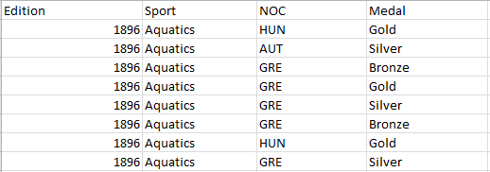
Data abstraction (attribute types)
Quantitative
(Continuous)
Nominal
Ordinal

Slide 21
Data abstraction (semantics)
Independent
Discrete Temporal Non Spatial
Dependent
Discrete
Temporal
Non Spatial
Dependent
Discrete Temporal
Spatial
Dependent
Discrete
Temporal
Non Spatial

Slide 22
Data abstraction
Description:
Total – A table containing the total number of medals won and for each type of medal.
Dataset type:
Organized as a tree, first by the country, then its NOC code, then by total Medals won, and then Medal specific (Gold,Silver,Bronze)

Slide 23
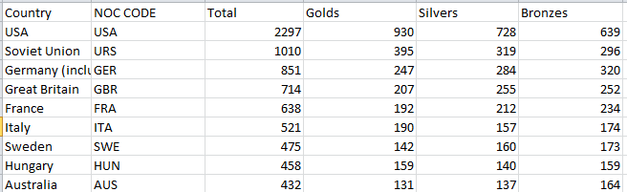
Data abstraction (attribute types)
Nominal
Quantitative (Ratio)

Slide 24
Data abstraction (semantics)
Independent
Discrete Non Temporal
Spatial
Independent
Discrete Non Temporal
Non Spatial

Slide 25
Data abstraction
Description:
Codes – A table containing all countries and for each its IOC and its 2letter ISO code
Dataset type:
Sets of 3 strings Country, IOC , 2 letter ISO code

Slide 26
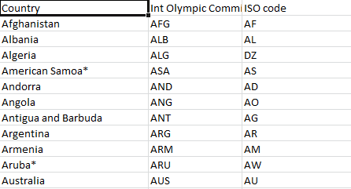
Data abstraction (attribute types)
Nominal

Slide 27
Data abstraction (semantics)
Independent
Discrete Non Temporal
Spatial

Slide 28
Data abstraction
Description:
Population – A table that for each country has its population since 1960.
Dataset type: A table with a 3-letter ISO country code matching the IOC, and a set of columns each pertaining to every fourth year between 1960 and 2008, containing the population of the country in that year.

Slide 29
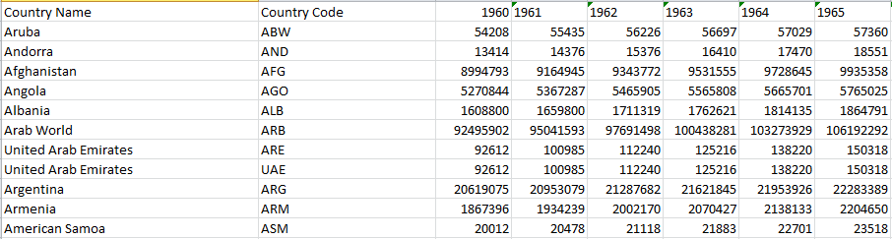
Data abstraction (attribute types)
Nominal
Quantitative (Ratio)

Slide 30
Data abstraction (semantics)
Independent
Discrete Non Temporal
Spatial
Dependent
Discrete Temporal
Non Spatial

Slide 31
Data abstraction
Description:
Coordinates – A table that for each country has its longitude and latitude coordinates.
Dataset type: A table with a 2-letter ISO country code for each country and a latitude and longitude for that country.

Slide 32
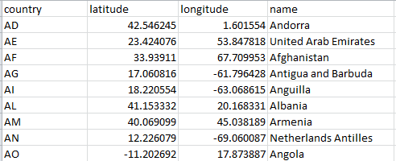
Data abstraction (attribute types)
Quantitative
(Continuous)
Nominal
Nominal

Slide 33
Data abstraction (semantics)
Independent
Discrete Non Temporal
Spatial
Dependent
Continuous Non Temporal
Spatial
Independent
Discrete Non Temporal
Spatial

Slide 34
Dataset processing
04

Slide 35
Dataset processing
Dataset cleaning description
Did all IOC values existed?
Were the IOC codes the same as NOC codes?
What to do with ISO codes with 3 letters?
(Parte do Miguel)

Slide 36

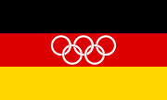

Dataset processing
Problem found
IOC Values didn’t exist

Slide 37

Dataset processing
Problem found
IOC Values don’t exist anymore

Slide 38
Dataset processing
Solution for Problem 1:
Gave the medals they won to the actual Germany
Germany | GER | DE | Germany
Germany | EUA | DE | Germany
Germany | FRG | DE | Germany
Germany | GDR | DE | Germany

Slide 39

Dataset processing
Problem found
IOC = NOC ?

Slide 40
Dataset processing
Problem found
IOC = NOC ?
IOC Code -> ROM
NOC Code -> ROU

Slide 41
Dataset processing
Solution for problem 2
Give to the IOC attribute, the values of NOC and IOC values
Romania | ROM | RO | Romania
Romania | ROU | RO | Romania
They were always the same!

Slide 42

Dataset processing
Problem found
3-letter ISO Codes Conflite
ISO Code -> PRT

Slide 43
Dataset processing
Solution for problem 3
Grant to Portugal, the IOC code, to prevent confusions.
Portugal | PRT | 8857716 | 8929316 | 8993985 | 9030355
Portugal | POR | 8857716 | 8929316 | 8993985 | 9030355

Slide 44
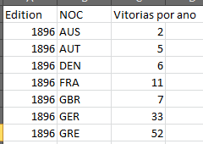
Dataset processing
How to get the winners/population coefficient?
We needed the amount of medals for each country, each year...
Edition | NOC | Medal
1896 | HUN | Gold
1896 | AUT | Silver
1896 | GRE | Bronze
Group By

Slide 45
Dataset processing
How to get the winners/population coefficient?
We also had the population

Slide 46
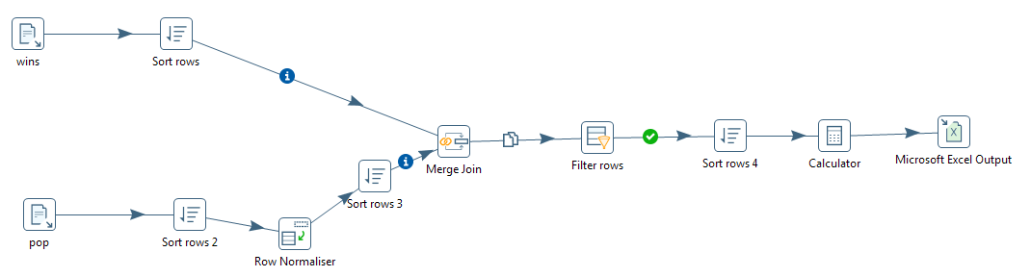
Dataset processing
How to get the winners/population coefficient?
We let Pentaho work on that...
Sort by country code
Merge by code Sort by code
Select those with Divide
equal years
Normalise by year
Sort by code

Slide 47

Dataset processing
How to get the winners/population coefficient?
We used Excel to calculate with the needed precision and we made the results more readable:
Medalists/Population x 1 000 000

Slide 48
Mapping
05

Slide 49
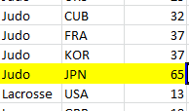
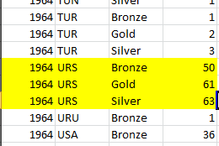
Mapping
1 – What countries had the most gold medallists in the first games, in 1896?
2 – What country has the most medallists in Judo?
3 – What are the standings of the USSR in 1964?

Slide 50
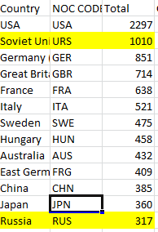
Mapping
4 – See the countries with the most medallists per capita in 2008.
5 – How do the USSR and Russia’s cumulative scores compare?

